Slide 1
Introduction to Generative AI: Exploring Tomorrow’s possibilities together
Abdul Mateen, 19.04.2024

Slide 2


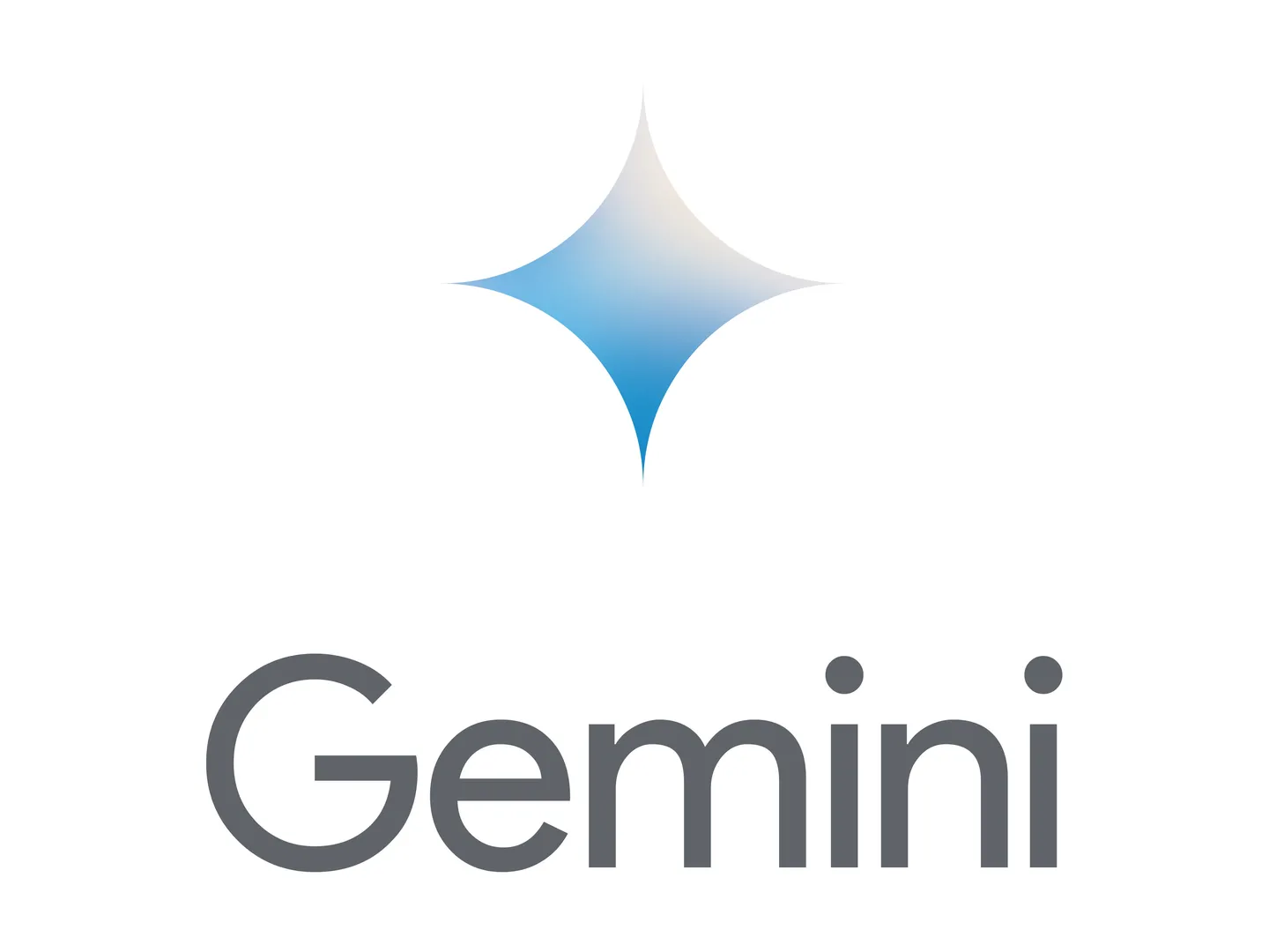
Agenda
What is Gen AI?
Gen AI Capabilities
Gen AI-Models
A Perfect Prompt
Art of Prompt Engineering
Fine Tuning Gen AI
Gen AI Pitfall
Demonstration

Slide 3
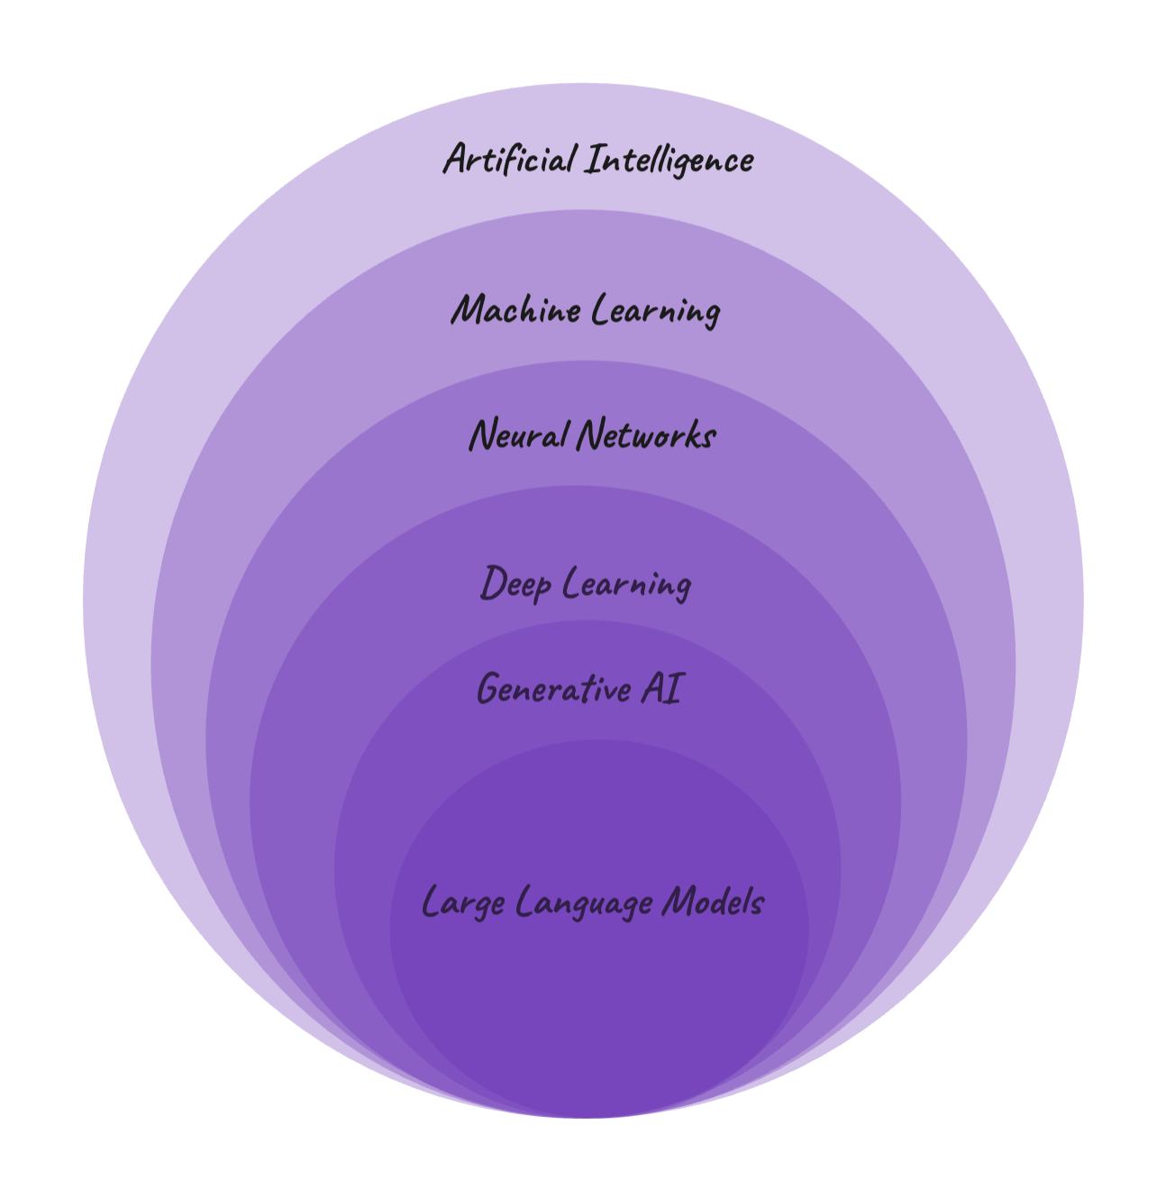
What is Gen AI?
Gen AI is a kind of AI that can create entirely new content. This content can be text, images, music, or even code. It works by analyzing existing data to learn patterns and relationships. Then, it uses this knowledge to produce new things that are similar to what it studied.
Notes:
Generative AI enables users to quickly generate new content based on a variety of inputs. Inputs and outputs to these models can include text, images, sounds, animation, 3D models, or other types of data.
Artificial Intelligence (AI) is a discipline, a branch of computer science, that deals with the creation and development of machines that think and act like humans.
Machine Learning (ML) is a subfield of AI. It is a program or system that trains a model from input data and then that trained model can make useful predictions from new or never before seen data.
Neural Networks (NNs) — also known as artificial neural networks (ANNs) or simulated neural networks (SNNs), are a subset of machine learning. The name and structure inspired by the human brain, mimicking the way that biological neurons signal to one another.² NN consist of interconnected artificial neurons organised in layers: an input layer, one or more hidden layers, and an output layer. NN are at the heart of deep learning algorithms.
Deep Learning(DL) is a subset of NN. The word deep here refers to the depth of layers in a neural network. Any neural network with more than three hidden layers can be considered a deep learning algorithm. Having a higher number of hidden layers, DL models are well-suited for tackling complex real-world problems. Everyday examples of technologies using NN and DL are: image recognition or object detection in smartphone cameras — such as Facial Recognition and Autofocus- and online language translation services like Google Translate.
Generative AI (GenAI) is subset of DL, a type of artificial intelligence technology that can generate different types of content - such as text, imagery, audio, video - based on what has learnt from existing content.
Large Language Model (LLM) is a form of generative AI, which focuses on generating human-like text based on the patterns learned from vast amounts of textual data during the training process. Note the difference between LLM and ML. Large Language Model is a specific type of machine learning model specialised in natural language processing, while ML is a broader field that encompasses various algorithms and techniques used across diverse domains to enable computers to learn from data and make predictions or decisions. ChatGPT is possibly the most famous example of technologies using LLM right now.

Slide 4
Gen AI Capabilities
Language
Gen AI excels at understanding and generating human-like text, enabling it to assist with tasks like writing, translation, and chatbots.
Marketing, Notes taking, Code development.
Visual
Cutting-edge Gen AI models can create photorealistic images from text descriptions, revolutionizing content creation and visual design.
Video generation, 3D models, Image generation.
Auditory
- Music Generation, Voice Generation

Slide 5
Gen AI Models
Large Language Models (LLMs)
Gemini
ChatGPT
LLama2
Claude
Falcon
Mistral
Large Vision Models (LVMs)
Stable Diffusion
Midjourney
CLIP by OpenAI
DALL·E
Claude
Gemini

Slide 6
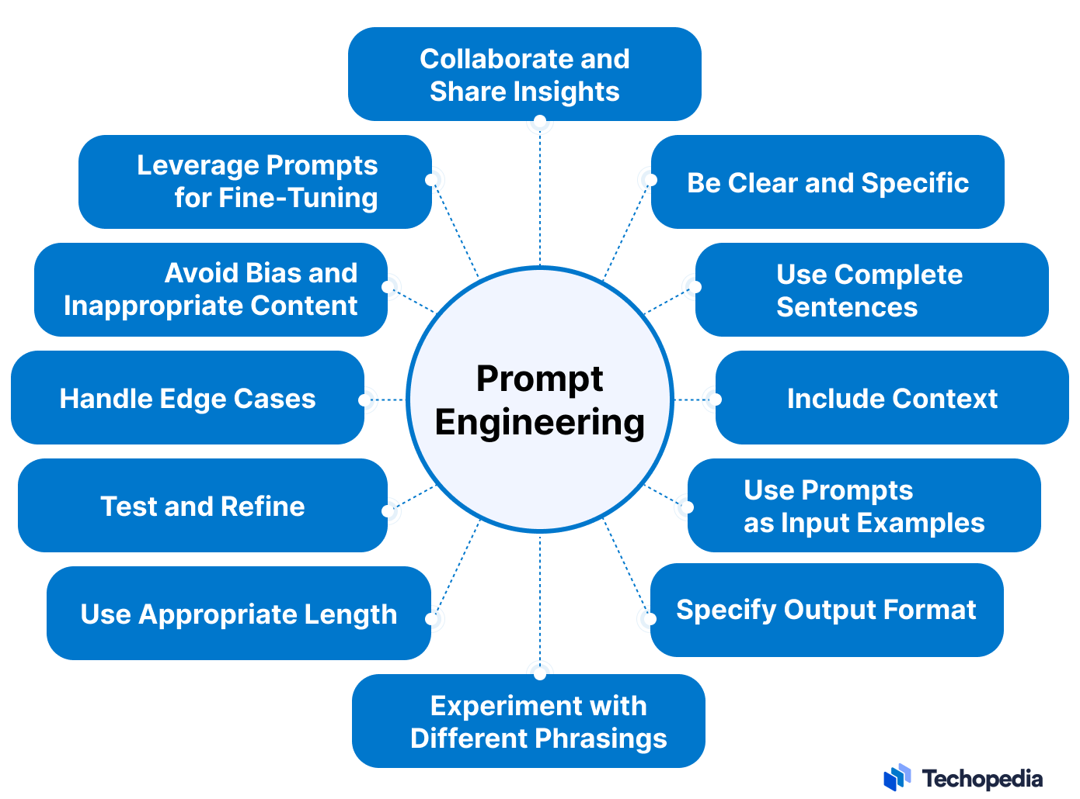
A Perfect Prompt
Prompt Engineering
Large language models can produce any sequence of characters. Literally any at very different levels of quality.
Mastering prompt engineering is key to unlocking the full potential of generative AI.
It involves thoughtful prompt design, iterative refinement, and understanding model capabilities.
Prompt Engineering Importance:
Precision and Relevance
Efficiency
Safety and Security
Customization
Notes:
Prompt engineering is the process of structuring an instruction that can be interpreted and understood by a generative AI model.

Slide 7
Art of Prompt Engineering
Elements of a Good Prompt: A well-crafted prompt typically includes the following components
Clarity: Clearly state the question or instruction to reduce ambiguity and improve the likelihood of receiving the desired response.
Context: Provide sufficient context to help the AI system understand the domain, scope, or user's intent. This can lead to more accurate and relevant results.
Specificity: Ensure that your prompt is specific enough to elicit the desired response, without being overly restrictive or leading.
Concision : Keep prompts concise to improve user experience and minimize confusion.

Slide 8
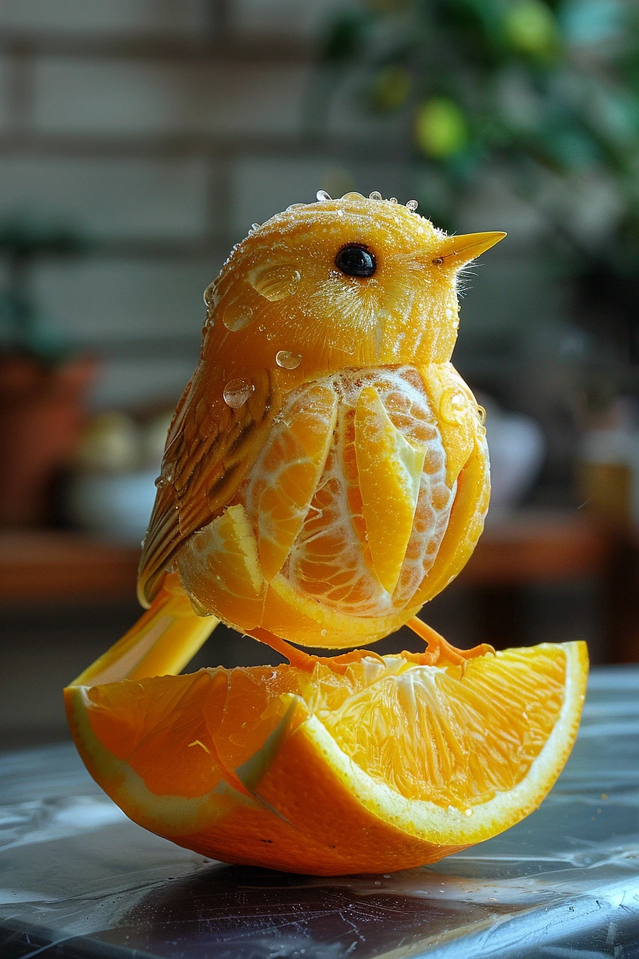
Types of Prompts
Zero-shot
One-, few-, and multi-shot
Chain-of-thought prompting
Zero-shot CoT
Prompt libraries for inspiration
PromptHero - Search prompts for Stable Diffusion, ChatGPT & Midjourney
Google Gemini prompt library:
Example Prompts, Code and Integrations | Google AI for Developers
A little bird made of a fresh orange that has been cut open, photo-realistic techniques --ar 2:3 --stylize 400
Notes:
Zero Shot is the simplest type of prompt. It provides no examples to the model, just the instruction. You can also phrase the instruction as a question, or give the model a "role
One-shot prompting shows the model one clear, descriptive example of what you'd like it to imitate.
Chain of Thought (CoT) prompting encourages the LLM to explain its reasoning. Combine it with few-shot prompting to get better results on more complex tasks that require reasoning before a response.
Zero-shot CoT
Recalling the zero-shot prompting from earlier, this approach takes a zero-shot prompt and adds an instruction: "Let's think step by step." The LLM is able to generate a chain of thought from this instruction, and usually a more accurate answer as well. This is a great approach to getting LLMs to generate correct answers for things like word problems.

Slide 9
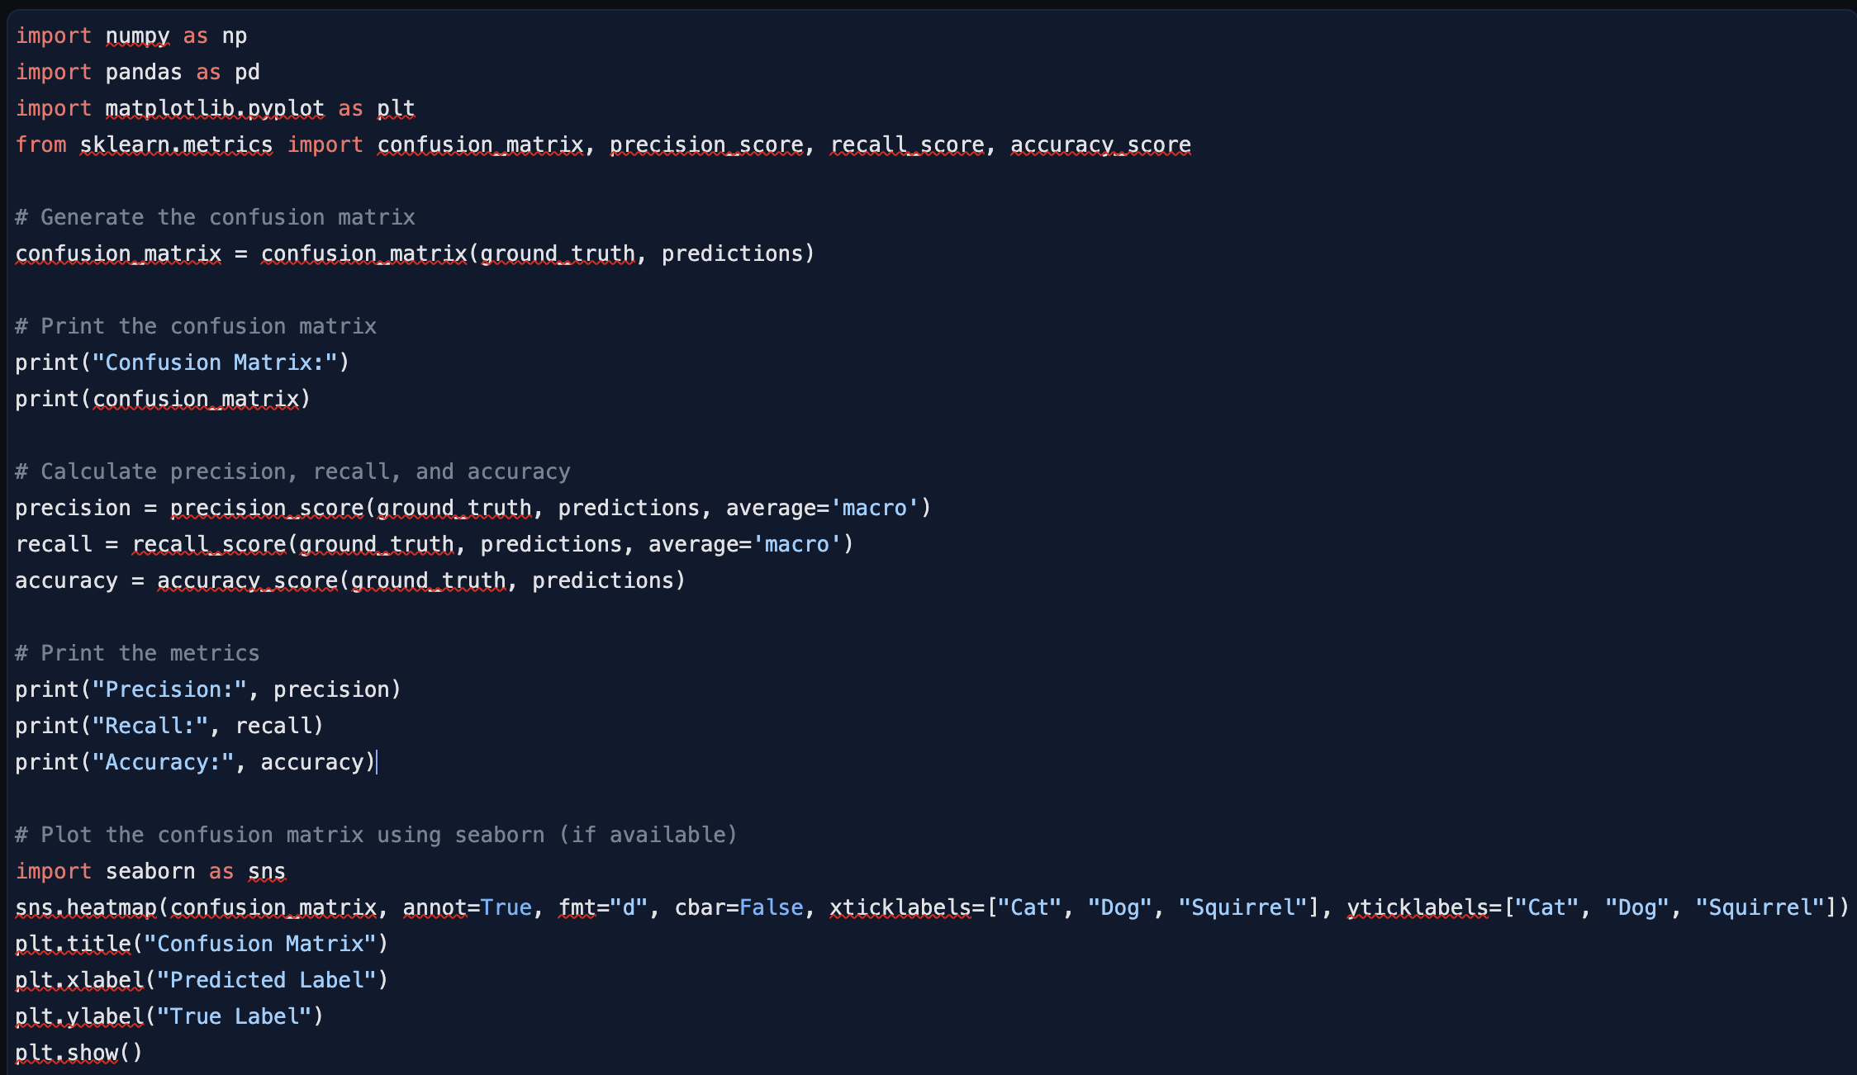
Types of Prompts (Cont.)
Prompt library Example (ML confusion matrix | Google AI Studio)
I am a student learning ML. I have a trained a model to predict whether an image is a cat, dog, or squirrel. These are the predictions I've gotten from my model, and the ground truth from my labels. Here, 0 corresponds to cat, 1 to dog, and 2 to squirrel.
predictions = [0, 0, 1, 1, 0, 0, 2, 2, 1, 0]
ground_truth = [0, 1, 1, 1, 1, 0, 2, 2, 2, 2]
I would like to make a confusion matrix using sklearn. I would also like to output metrics like precision, recall, and accuracy. And I would like to visualize the confusion matrix by plotting it. The plot should show the class names instead of the numeric labels.
Can you generate code to do this for me in Python? ﻿

Slide 10
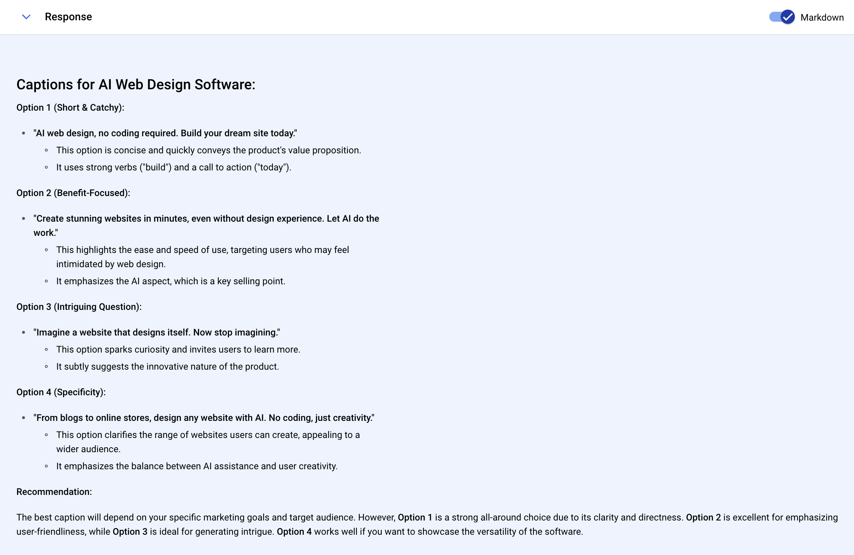
Art of Prompt Engineering
Analyzing Good and Not-So-Good Prompts | Example 01
Not-so-Good Prompt:
“Write captions for a software product that generates web page design using AI and no coding necesssary. Explain why you recommend those captions.”

Slide 11
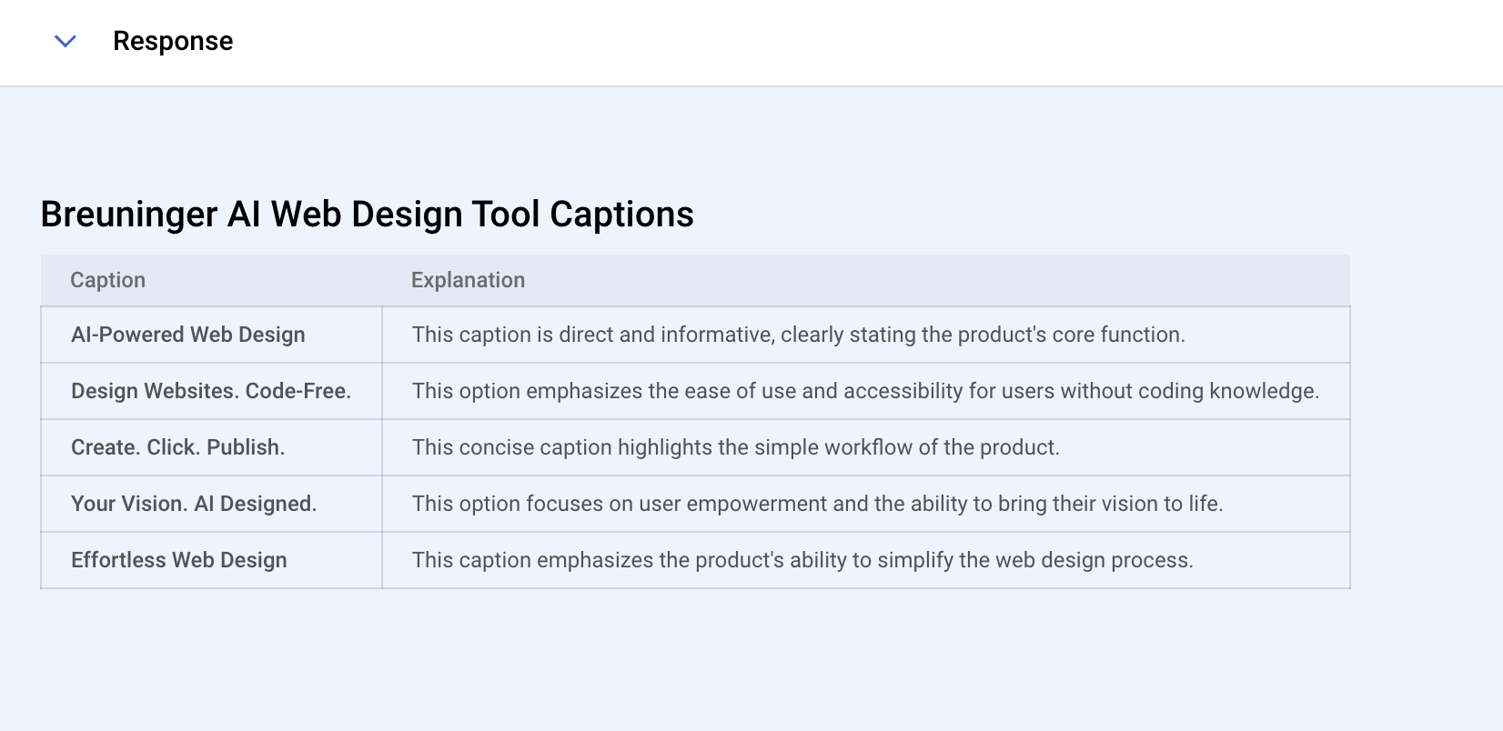
Art of Prompt Engineering (Cont.)
Example 01
Good Prompt:
Persona:
You are a content expert at a company, Breuninger, with a product that generates web page design using AI and no coding necessary.
Context:
You are tasked to write a product caption no longer than 5 words.
Action:
Write 5 product captions for Breuninger and provide a short explanation recommending each caption.
Tone:
Please keep the tone proffessional.
Output Format:
Please format the output in a table that can be copied to Excel.

Slide 12
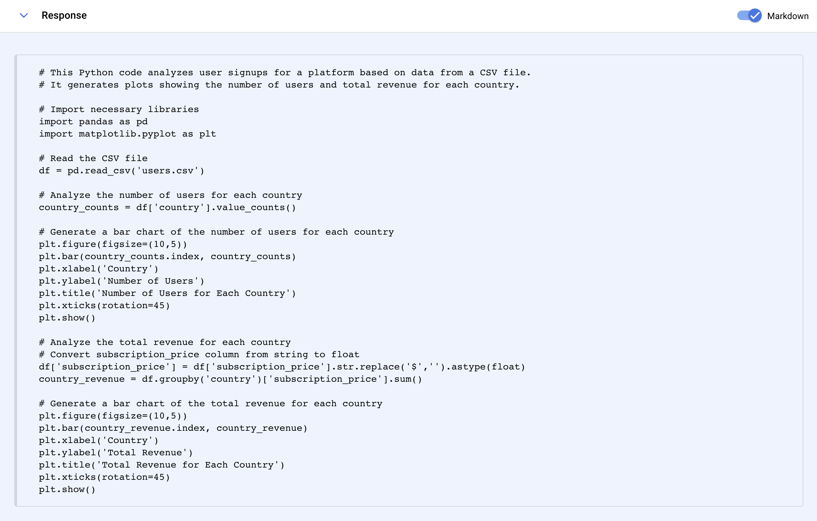
Art of Prompt Engineering (Cont.)
Example 02
Good Prompt: You are a marketing data analysis expert at analyzing user sign ups for the platform using your custom python code.
You are working with .csv data with user_id as an integer, signup_date (e.g 12/1/2023), country as a string and subscription_price as a string(e.g $9.99) in a file named users.csv
I want you to give me python code to read this file and generate plots using this data for the following:
- number of users for each country
- total revenue per country
Please include comments in the code and a summary of the purpose of the code at the top

Slide 13

Fine Tuning Gen AI
What is Token?
For language models, text is like a Lego set built from tokens. While tokens are the individual pieces, the real meaning comes from how they fit together. Different models have limits on how many Lego bricks (tokens) they can handle at once.
Rules of thumb for understanding tokens in terms of lengths: 1 token ~= 4 chars in English
Notes:
Why do we need to tokenize strings?
To break down complex text into manageable units.
To present text in a format that is easier to analyze or perform operations on.
Useful for specific linguistic tasks like part-of-speech tagging, syntactic parsing, and named entity recognition.
Uniformly preprocess text in NLP applications and create structured training data.

Slide 14
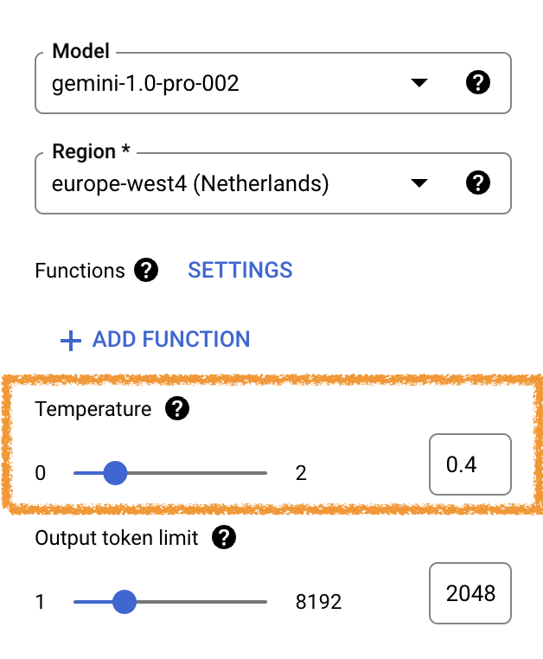
Fine Tuning Gen AI (Cont.)
Temperature
Controls randomness of outputs, like a thermostat for creativity.
Increase Temperature (More Randomness):
More creative and diverse outputs (e.g., surprising poems, abstract art)
Potentially less relevant or nonsensical outputs
Decrease Temperature (Less Randomness):
More conservative and predictable outputs (e.g., clear stories, realistic images)
Less creative and potentially limited options
Finding the Sweet Spot:
Experiment to balance creativity and relevance.
Caution: High temperature can increase hallucinations (irrelevant outputs).

Slide 15
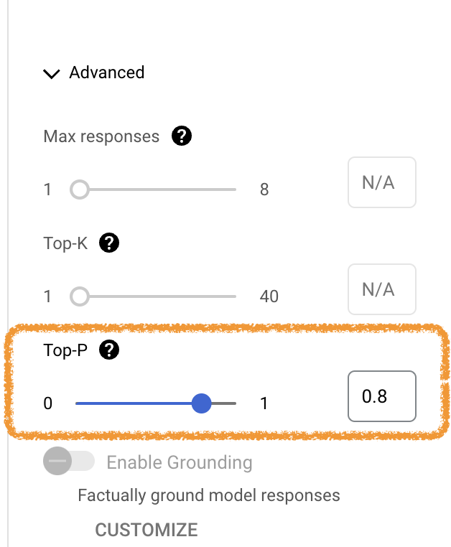
Fine Tuning Gen AI (Cont.)
Top P (Nucleus Sampling)
Focuses attention on probable next words: Top P acts like a spotlight, considering only the most likely words based on a set probability threshold.
Controls output creativity:
Lower P (narrow spotlight):
Chooses from a smaller set of high-probability words.
Generates more focused and controlled outputs.
Higher P (wider spotlight):
Considers a larger set of words.
Allows for more creativity but can be less predictable.
Notes:
Example: Suppose tokens A, B, and C have a probability of 0.3, 0.2 & 0.1 to be the next token. The Top P is 0.5. In this case, the model will select from either A or B as the next token (using temperature) and not C, because the cumulative probability of Top P<=0.5

Slide 16
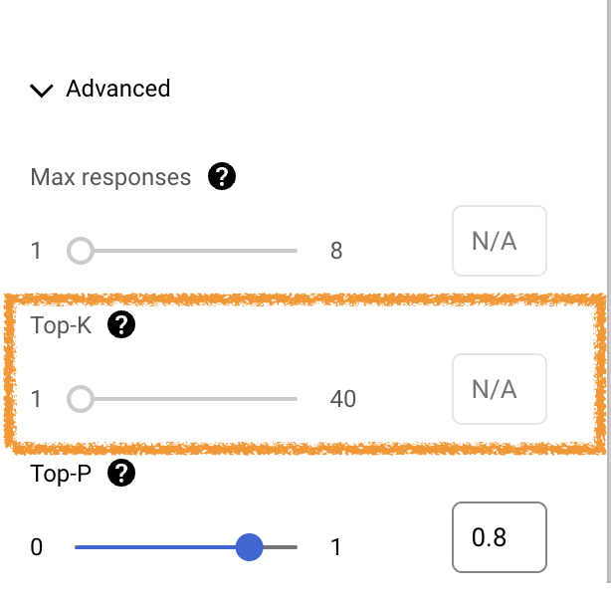
Fine Tuning Gen AI (Cont.)
Top K Sampling
Focuses on most probable continuations: Limits selection to the top K most likely words at each step, prioritizing conventional and safe outputs.
Controls creativity:
Lower K (narrower focus): More predictable, less creative outputs (considers fewer tokens).
Higher K (wider focus): More creative outputs (considers more tokens), but potentially less safe.
Note: Some models does not support this parameter.

Slide 17
Fine Tuning Gen AI (Cont.)
Token Selection Steps (🔄):
Top K tokens with highest probabilities are sampled.
Tokens further filtered based on Top P.
With final token being selected using temperature.
Choosing the Right Settings:
The ideal configuration depends on your desired outcome.
For tasks requiring accuracy and focus (like code completion) use lower temperature, higher Top P/Top K, and a moderate number of max tokens.
For creative writing, experiment with higher temperature, lower Top P/Top K, and a larger max token limit.
Notes:
By understanding and adjusting these parameters, you can transform generative AI models from generic text generators into powerful tools that align with your creative vision and enhance your workflow.

Slide 18
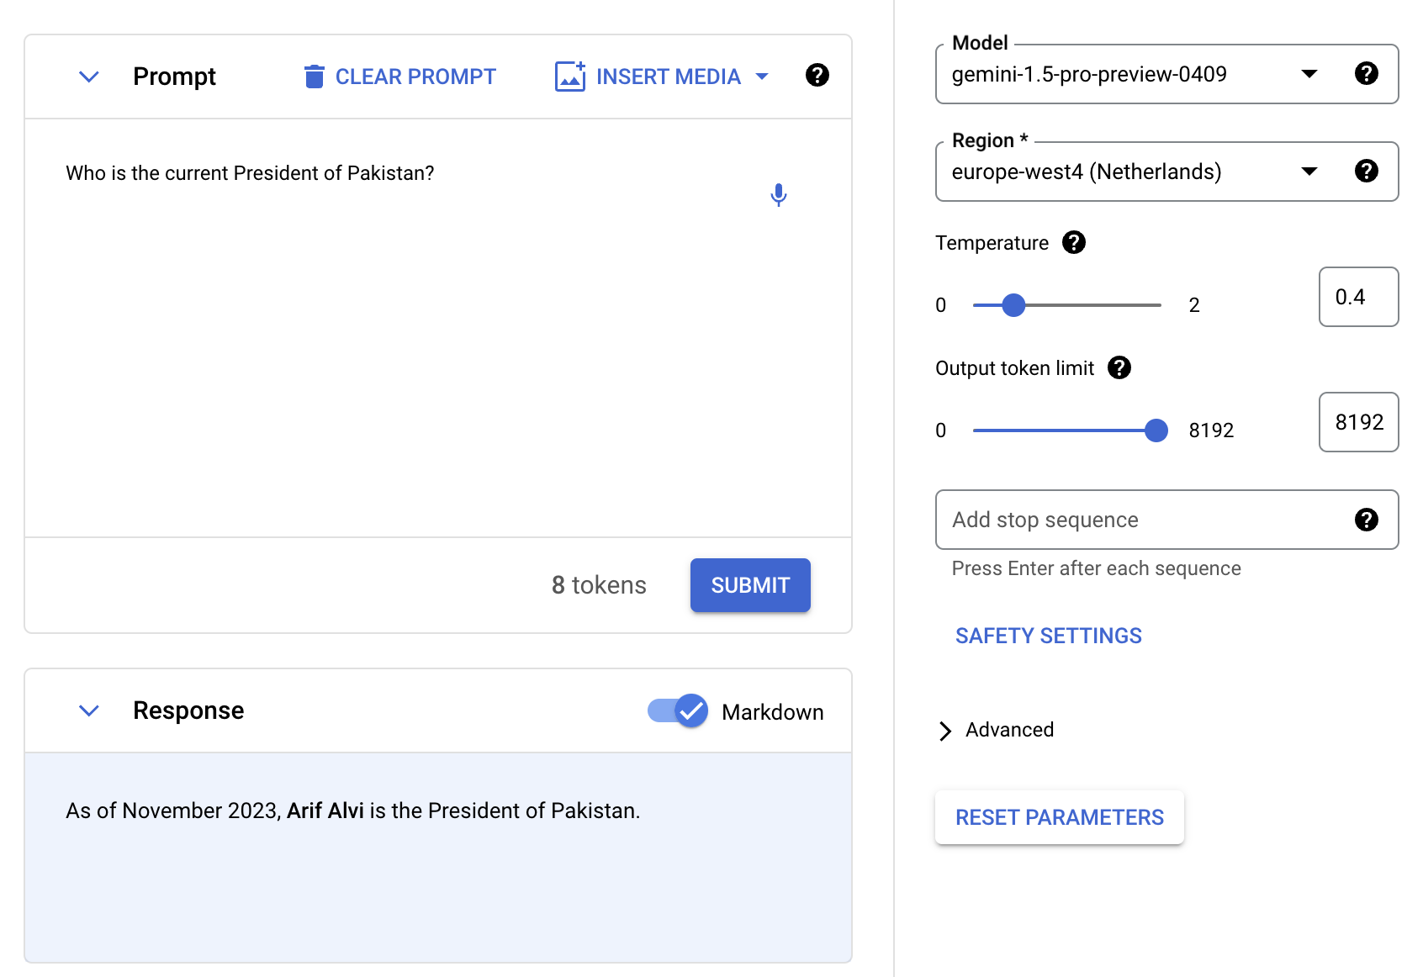
Gen AI Pitfall

Slide 19

Gen AI Pitfall (Cont.)

Slide 20

Demonstration
Semantic analysis
Text to SQL
Confluence question answers Chatbot
https://github.com/abdulmateen59/genAI-dps
Misc tools:
OutfitAnyone
Ollama
Cody

Slide 21
Questions?

Slide 22

Dive Deeper
Free Courses
Generative AI Explained
Getting Started with AI on Jetson Nano
Essentials of Developing Omniverse Kit Applications
Augment your LLM Using Retrieval Augmented Generation
Building RAG Agents with LLMs

